Slide 1
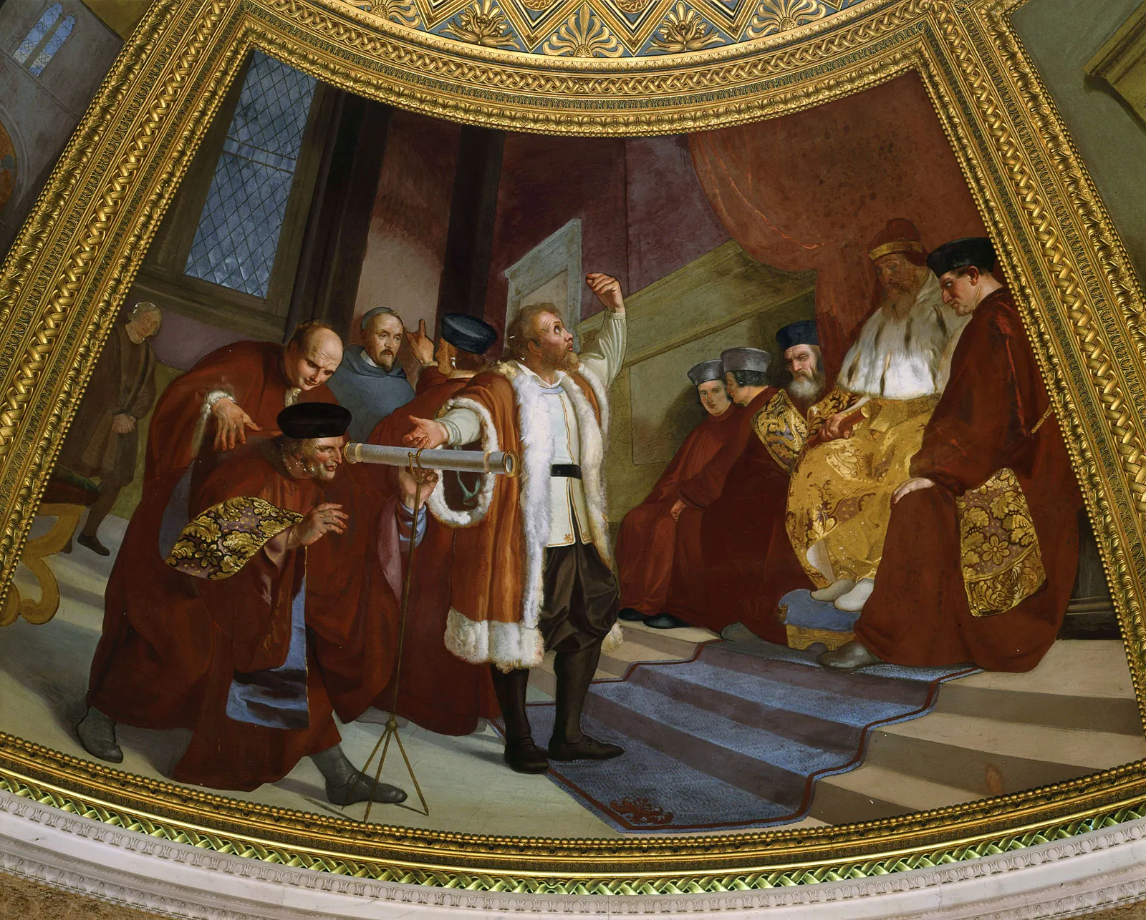
Replication/Revision/Rejection
Conclusion
L(M|D) ∝ P(D|M) Frequentist
P(M|D) ∝ P(D|M) · P(M) Bayesian
Causal claim
Causal effects Explanations
Causal inference
Galileo Galilei (1564-1642) the “father of modern science”
Data
Model
Inference algorithm
Statistical inference Machine learning
Observations
Predictions
P(D|M)
Natural process
Causal model
DGP model
Probability theory
Inductive reasoning
Real world
Abstract world
Propositional logic Deductive reasoning
Empiricism
Rationalism
Notes:
A probability model is the triplet (Ω, σ-algebra, P)
Generative vs Discriminative

Slide 2
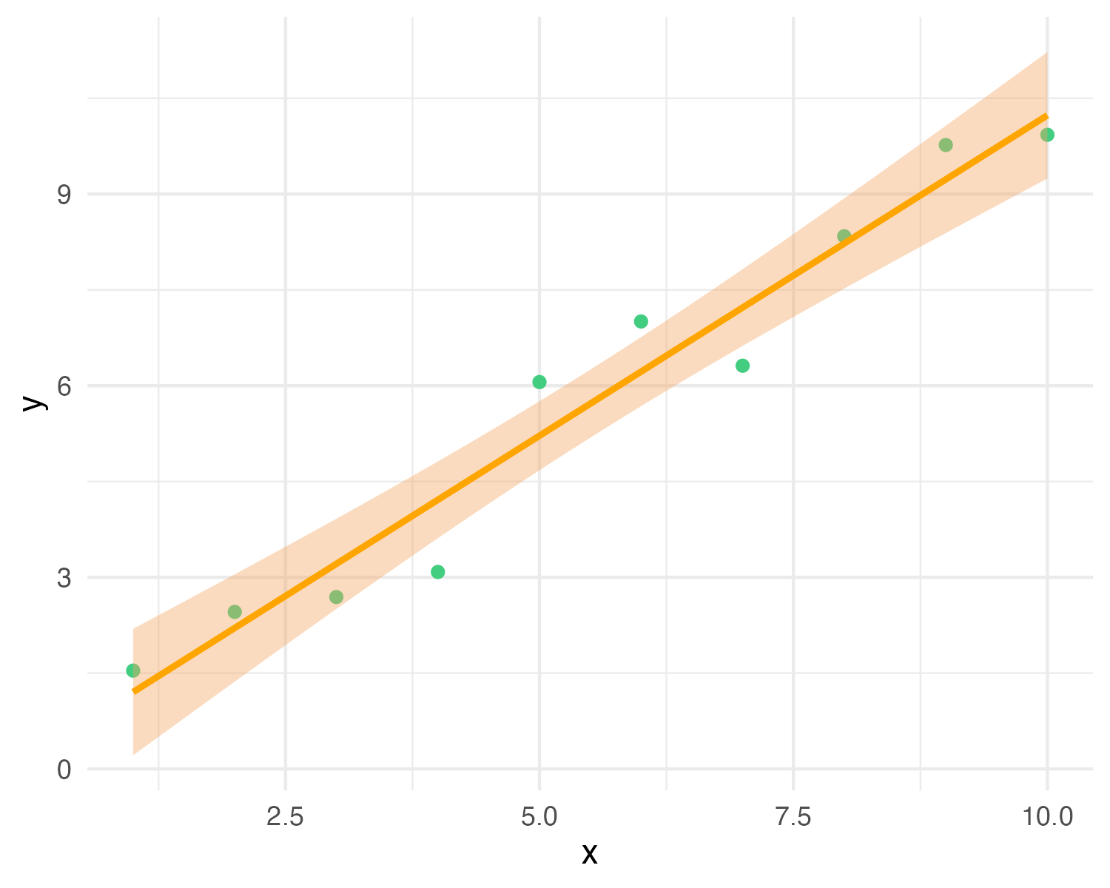
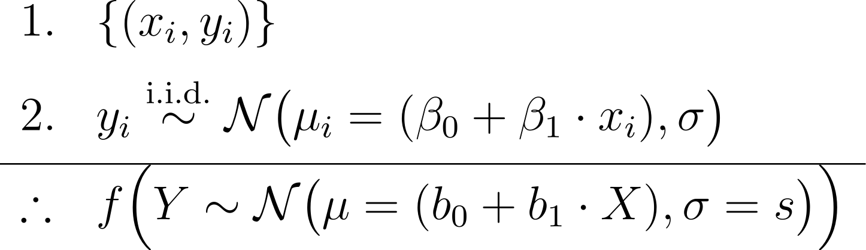
y_{i} ∼ N(μ_{i} = (β₀ + β₁ · x_{i}), σ)
premises assumptions evidence KB
premises
data
causal model
conclusion
likelihood (+ prior)
estimator
Y = b₀ + b₁X with CI
MLE (or posterior) predictive model
effect
= conclusion claim hypothesis query
Notes:
In Bayesian inference we add priors to the premises, and obtain a joint posterior distribution of the parameters conditioned on the data p(beta0, beta1, sigma | data), or a posterior predictive distribution as conclusion
In frequentist inference we obtain maximum-likelihood estimates of the parameters (b0, b1, s)
https://latex.unacademy.com/
\begin{array}{ll}
1. & \{(x_i, y_i)\} \\[6pt]
2. & y_i \stackrel{\text{i.i.d.}}{\sim} \mathcal{N}\bigl(\mu_i = (\beta_0 + \beta_1 \cdot x_i), \sigma\bigr) \\[4pt]
\hline
\therefore & f \Bigl(Y \sim \mathcal{N}\bigl(\mu = (b_0 + b_1 \cdot X), \sigma = s\bigr)\Bigr) \\
\end{array}

Slide 3
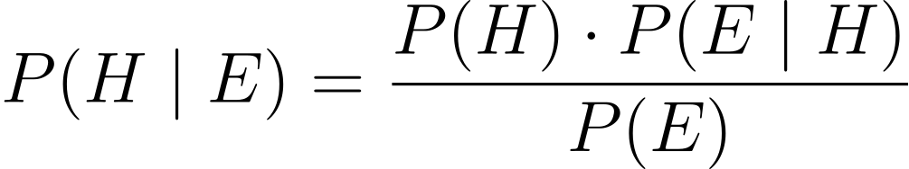
PRIOR
LIKELIHOOD
POSTERIOR
EVIDENCE

Slide 4
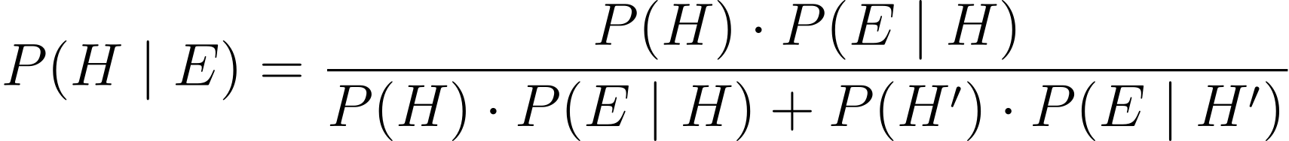
PRIOR
LIKELIHOOD
POSTERIOR
EVIDENCE

Slide 5
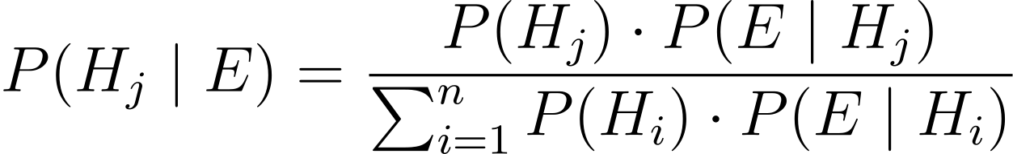
PRIOR
LIKELIHOOD
POSTERIOR
EVIDENCE

Slide 6
POSTERIOR
PRIOR
LIKELIHOOD

Slide 7
PRIOR
LIKELIHOOD
POSTERIOR
EVIDENCE

Slide 8
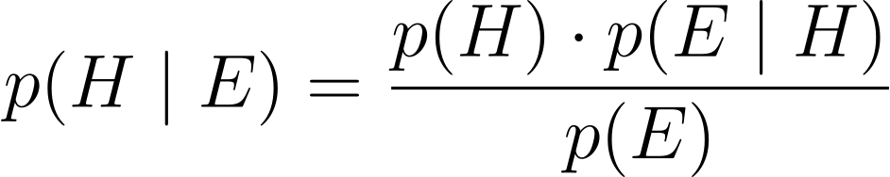
PRIOR
LIKELIHOOD
POSTERIOR
EVIDENCE

Slide 9
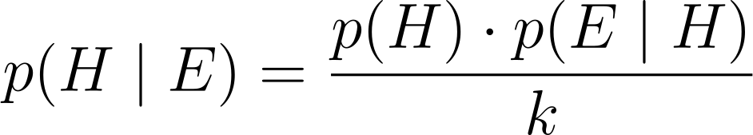
PRIOR
LIKELIHOOD
POSTERIOR
KNOWN NORMALIZING CONSTANT

Slide 10
POSTERIOR
PRIOR
LIKELIHOOD

Slide 11
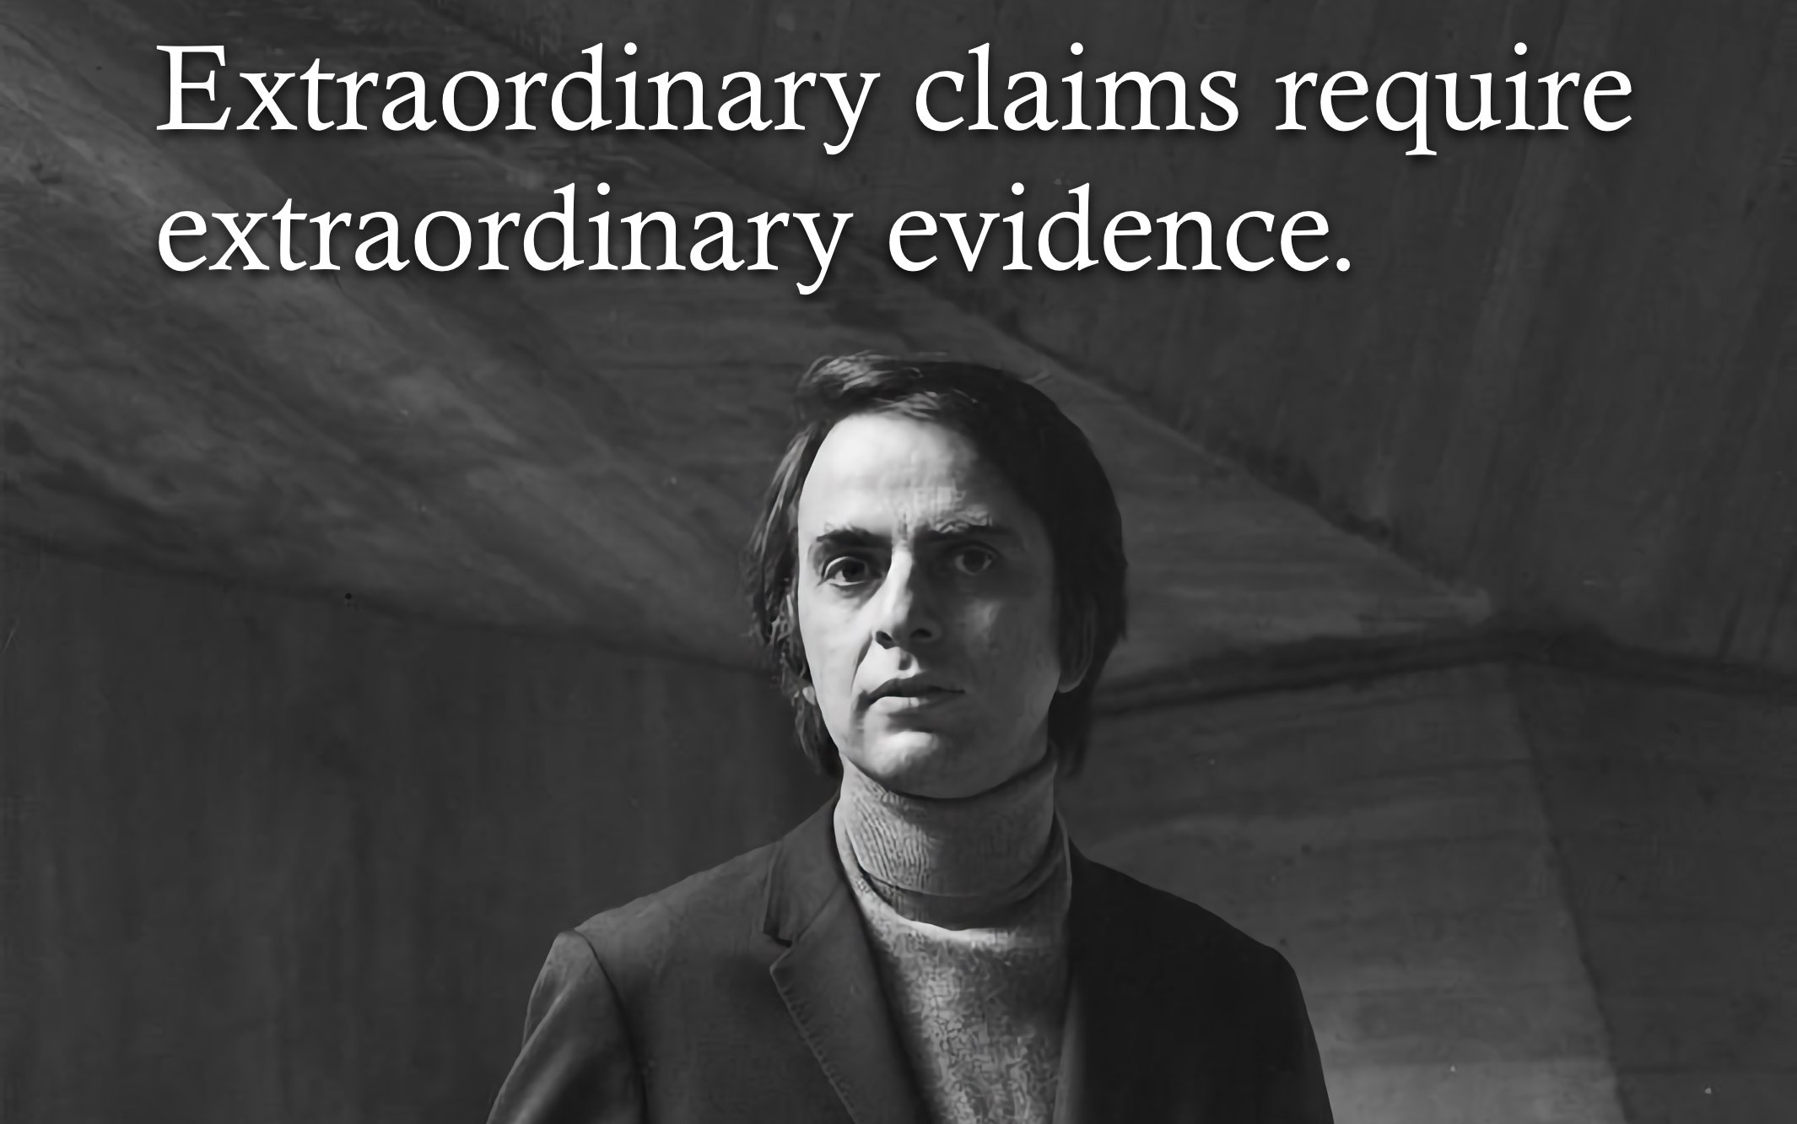
POSTERIOR
PRIOR
LIKELIHOOD

Slide 12
PRIOR
LIKELIHOOD
POSTERIOR
EVIDENCE

Slide 13
LIKELIHOOD
EVIDENCE

Slide 14
LIKELIHOOD
UNKNOWN CONSTANT

Slide 15
LIKELIHOOD
UNKNOWN CONSTANT

Slide 16
LIKELIHOOD FUNCTION
LIKELIHOOD
UNKNOWN CONSTANT

Slide 17
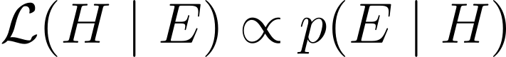
LIKELIHOOD FUNCTION
LIKELIHOOD

Slide 18

Notes:
A probability model is the triplet (Ω, σ-algebra, P)
Generative vs Discriminative

Slide 19
Replication/Revision/Rejection
Conclusion
L(M|D) ∝ P(D|M) Frequentist
P(M|D) ∝ P(D|M) · P(M) Bayesian
Causal claim
Causal effects Explanations
Causal inference
Data
Model
Inference algorithm
Statistical inference Machine learning
Observations
Predictions
P(D|M)
Natural process
Causal model
DGP model
Probability theory
Inductive reasoning
Real world
Abstract world
Propositional logic Deductive reasoning
Empiricism
Rationalism
Notes:
A probability model is the triplet (Ω, σ-algebra, P)
Generative vs Discriminative

Slide 20



Slide 21
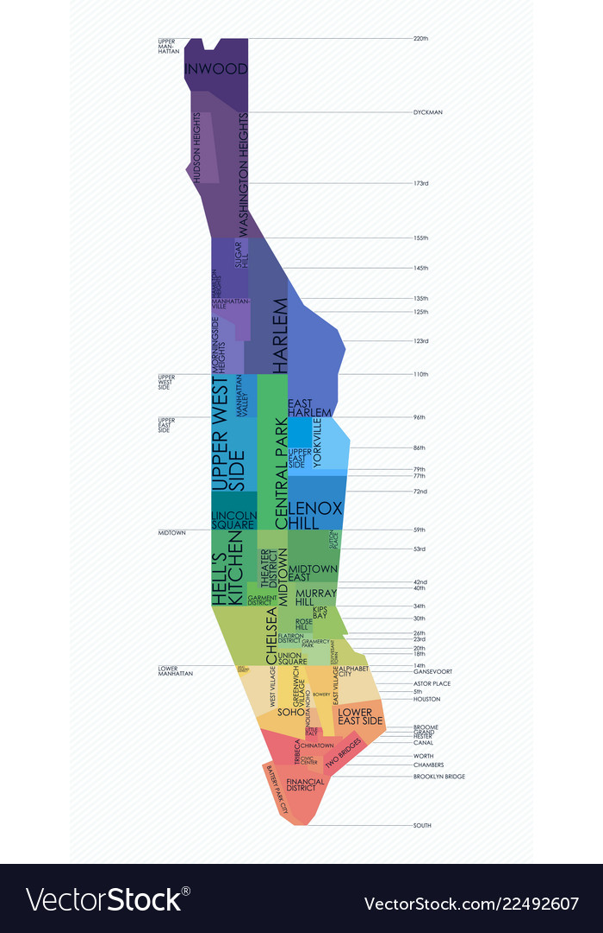
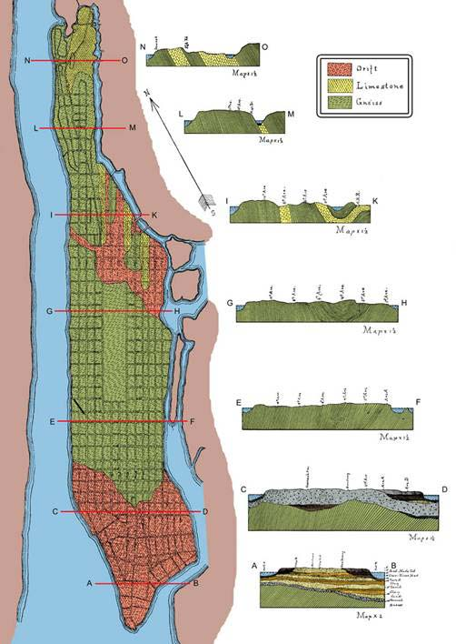

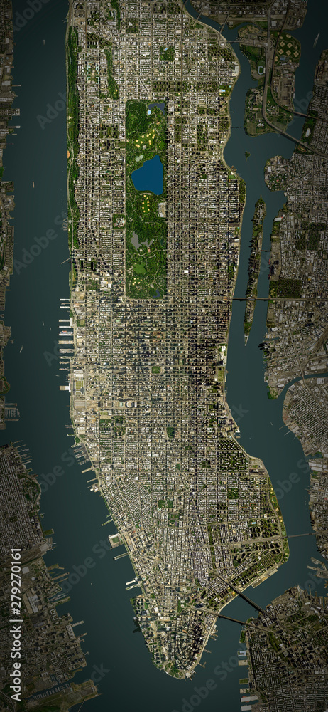
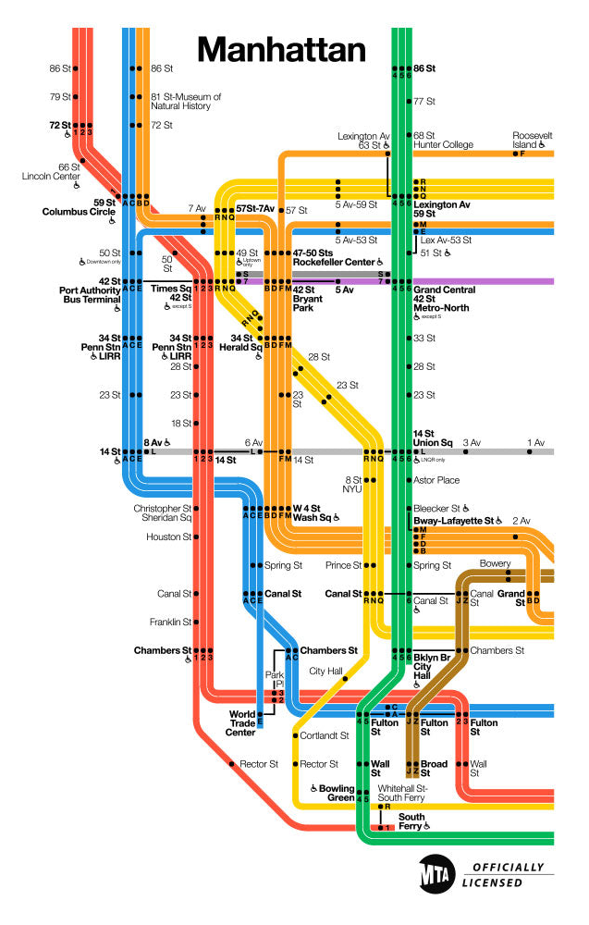
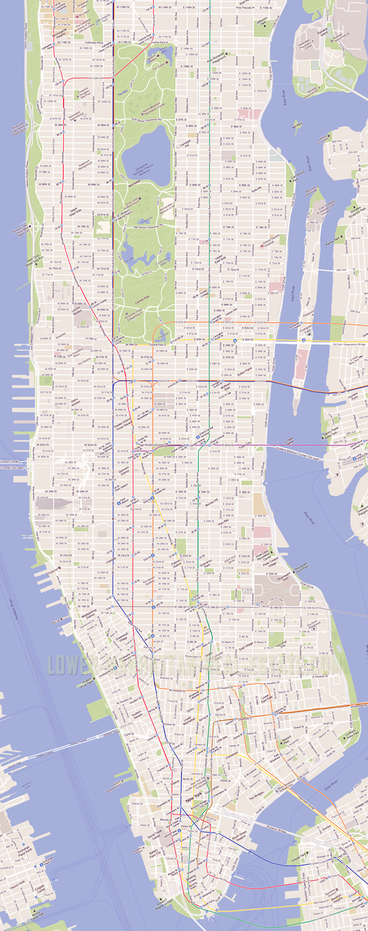

Slide 22

p(⍵ | M) =
ChatGPT™ = very complex function with >100 billion parameters

Slide 23
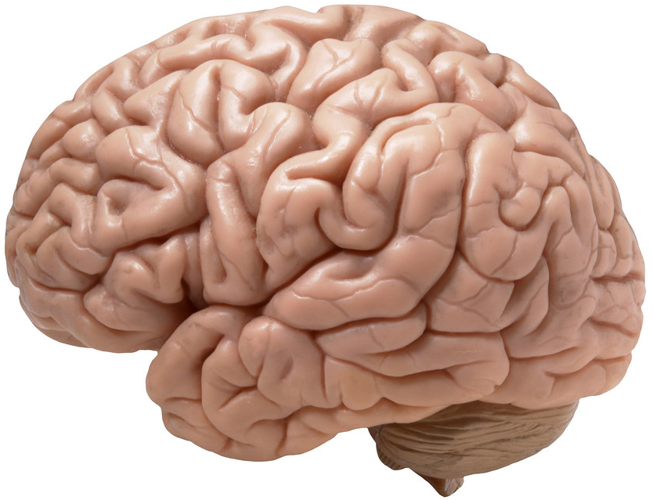
hBrain
p(⍵ | M) =
hBrain™ = very complex function with >100 trillion parameters

Slide 24
PRIOR
LIKELIHOOD
POSTERIOR
EVIDENCE

Slide 25
PRIOR
LIKELIHOOD
POSTERIOR
EVIDENCE

Slide 26
PRIOR
LIKELIHOOD
POSTERIOR
EVIDENCE

Slide 27
POSTERIOR
PRIOR
LIKELIHOOD

Slide 28
PRIOR
LIKELIHOOD
POSTERIOR
EVIDENCE

Slide 29
PRIOR
LIKELIHOOD
POSTERIOR
EVIDENCE

Slide 30
PRIOR
LIKELIHOOD
POSTERIOR
KNOWN NORMALIZING CONSTANT

Slide 31
POSTERIOR
PRIOR
LIKELIHOOD

Slide 32
PRIOR
LIKELIHOOD
POSTERIOR
EVIDENCE

Slide 33
LIKELIHOOD
EVIDENCE

Slide 34
LIKELIHOOD
UNKNOWN CONSTANT

Slide 35
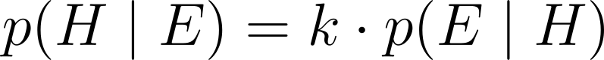
LIKELIHOOD
UNKNOWN CONSTANT

Slide 36
LIKELIHOOD FUNCTION
LIKELIHOOD
UNKNOWN CONSTANT

Slide 37
LIKELIHOOD FUNCTION
LIKELIHOOD

Slide 38
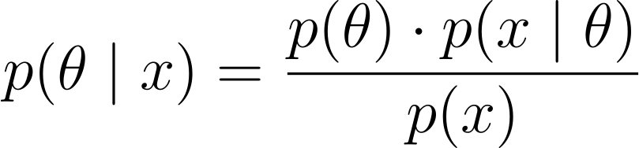

Slide 39
PRIOR
LIKELIHOOD
POSTERIOR
KNOWN NORMALIZING CONSTANT

Slide 40
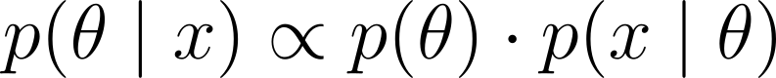
POSTERIOR
PRIOR
LIKELIHOOD

Slide 41
LIKELIHOOD
UNKNOWN CONSTANT

Slide 42
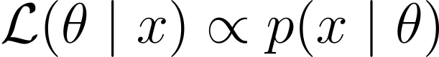
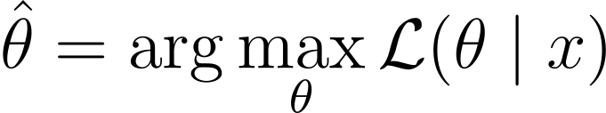
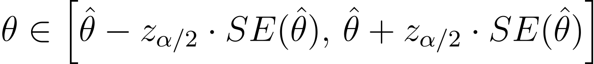
LIKELIHOOD
Maximum Likelihood Estimate (MLE)
Confidence Interval (CI)

Slide 43
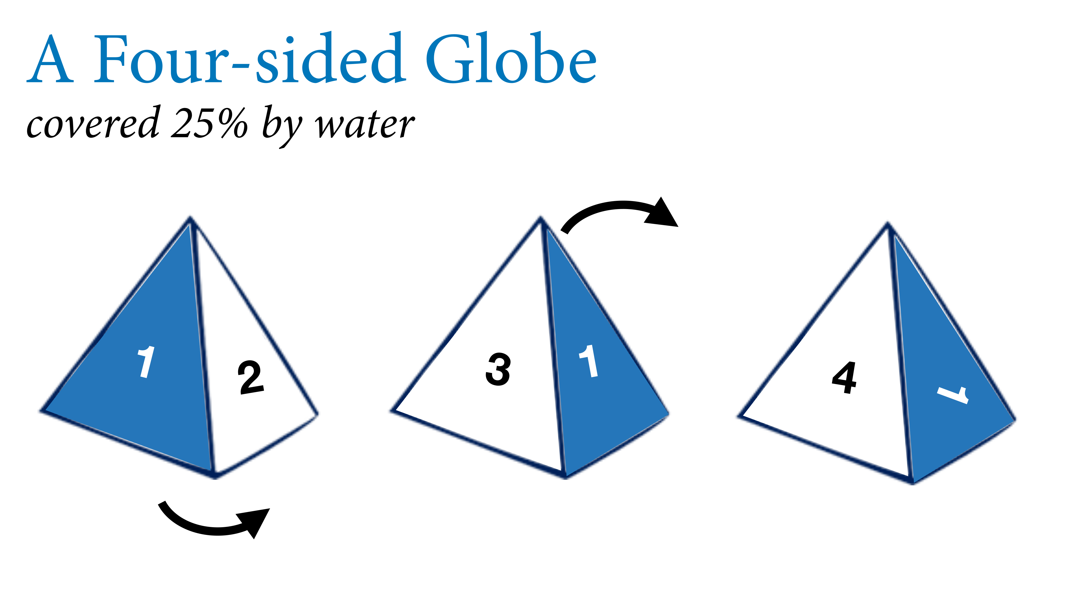
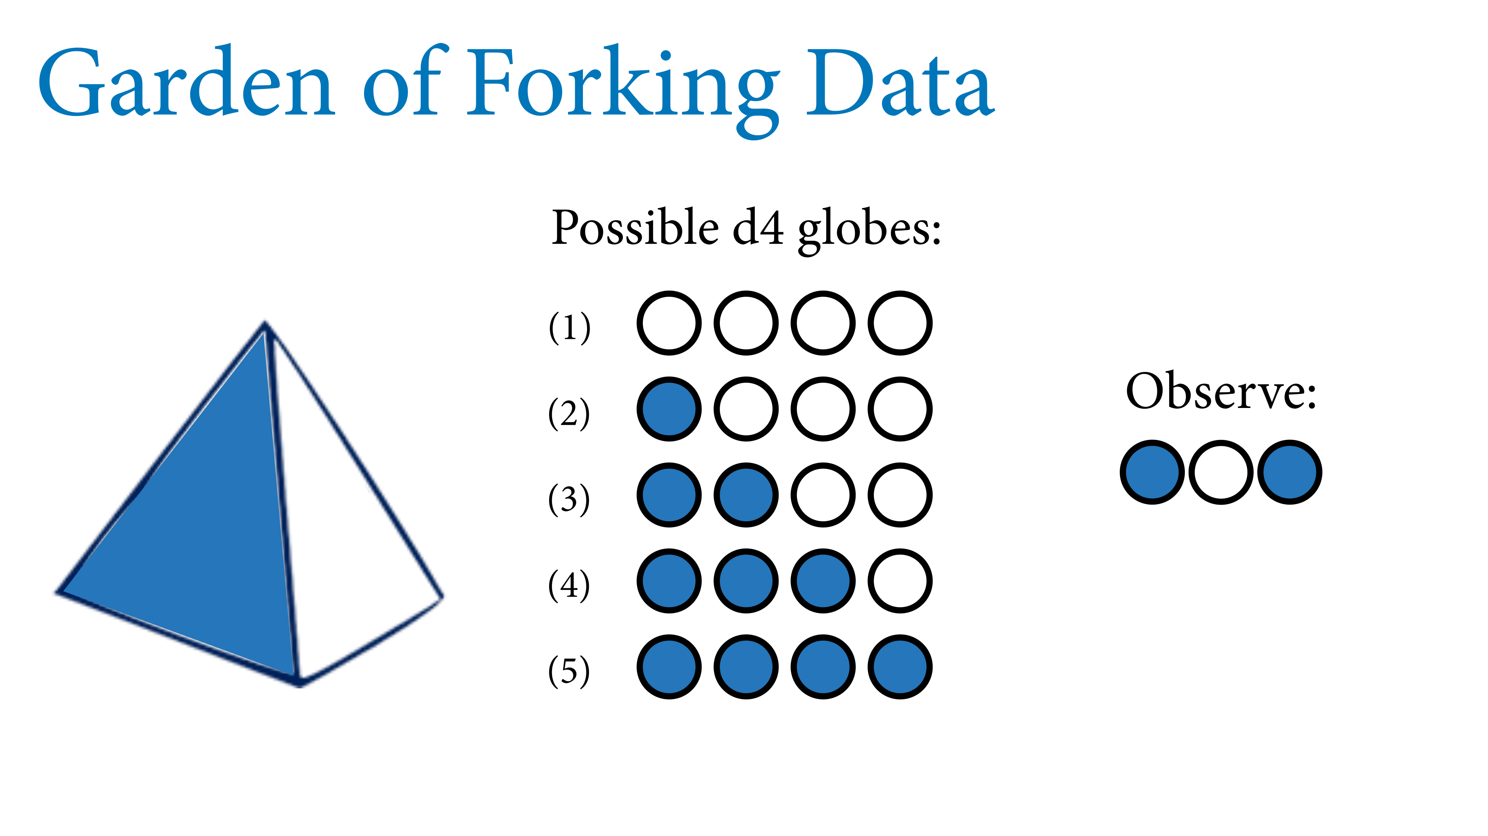

Slide 45
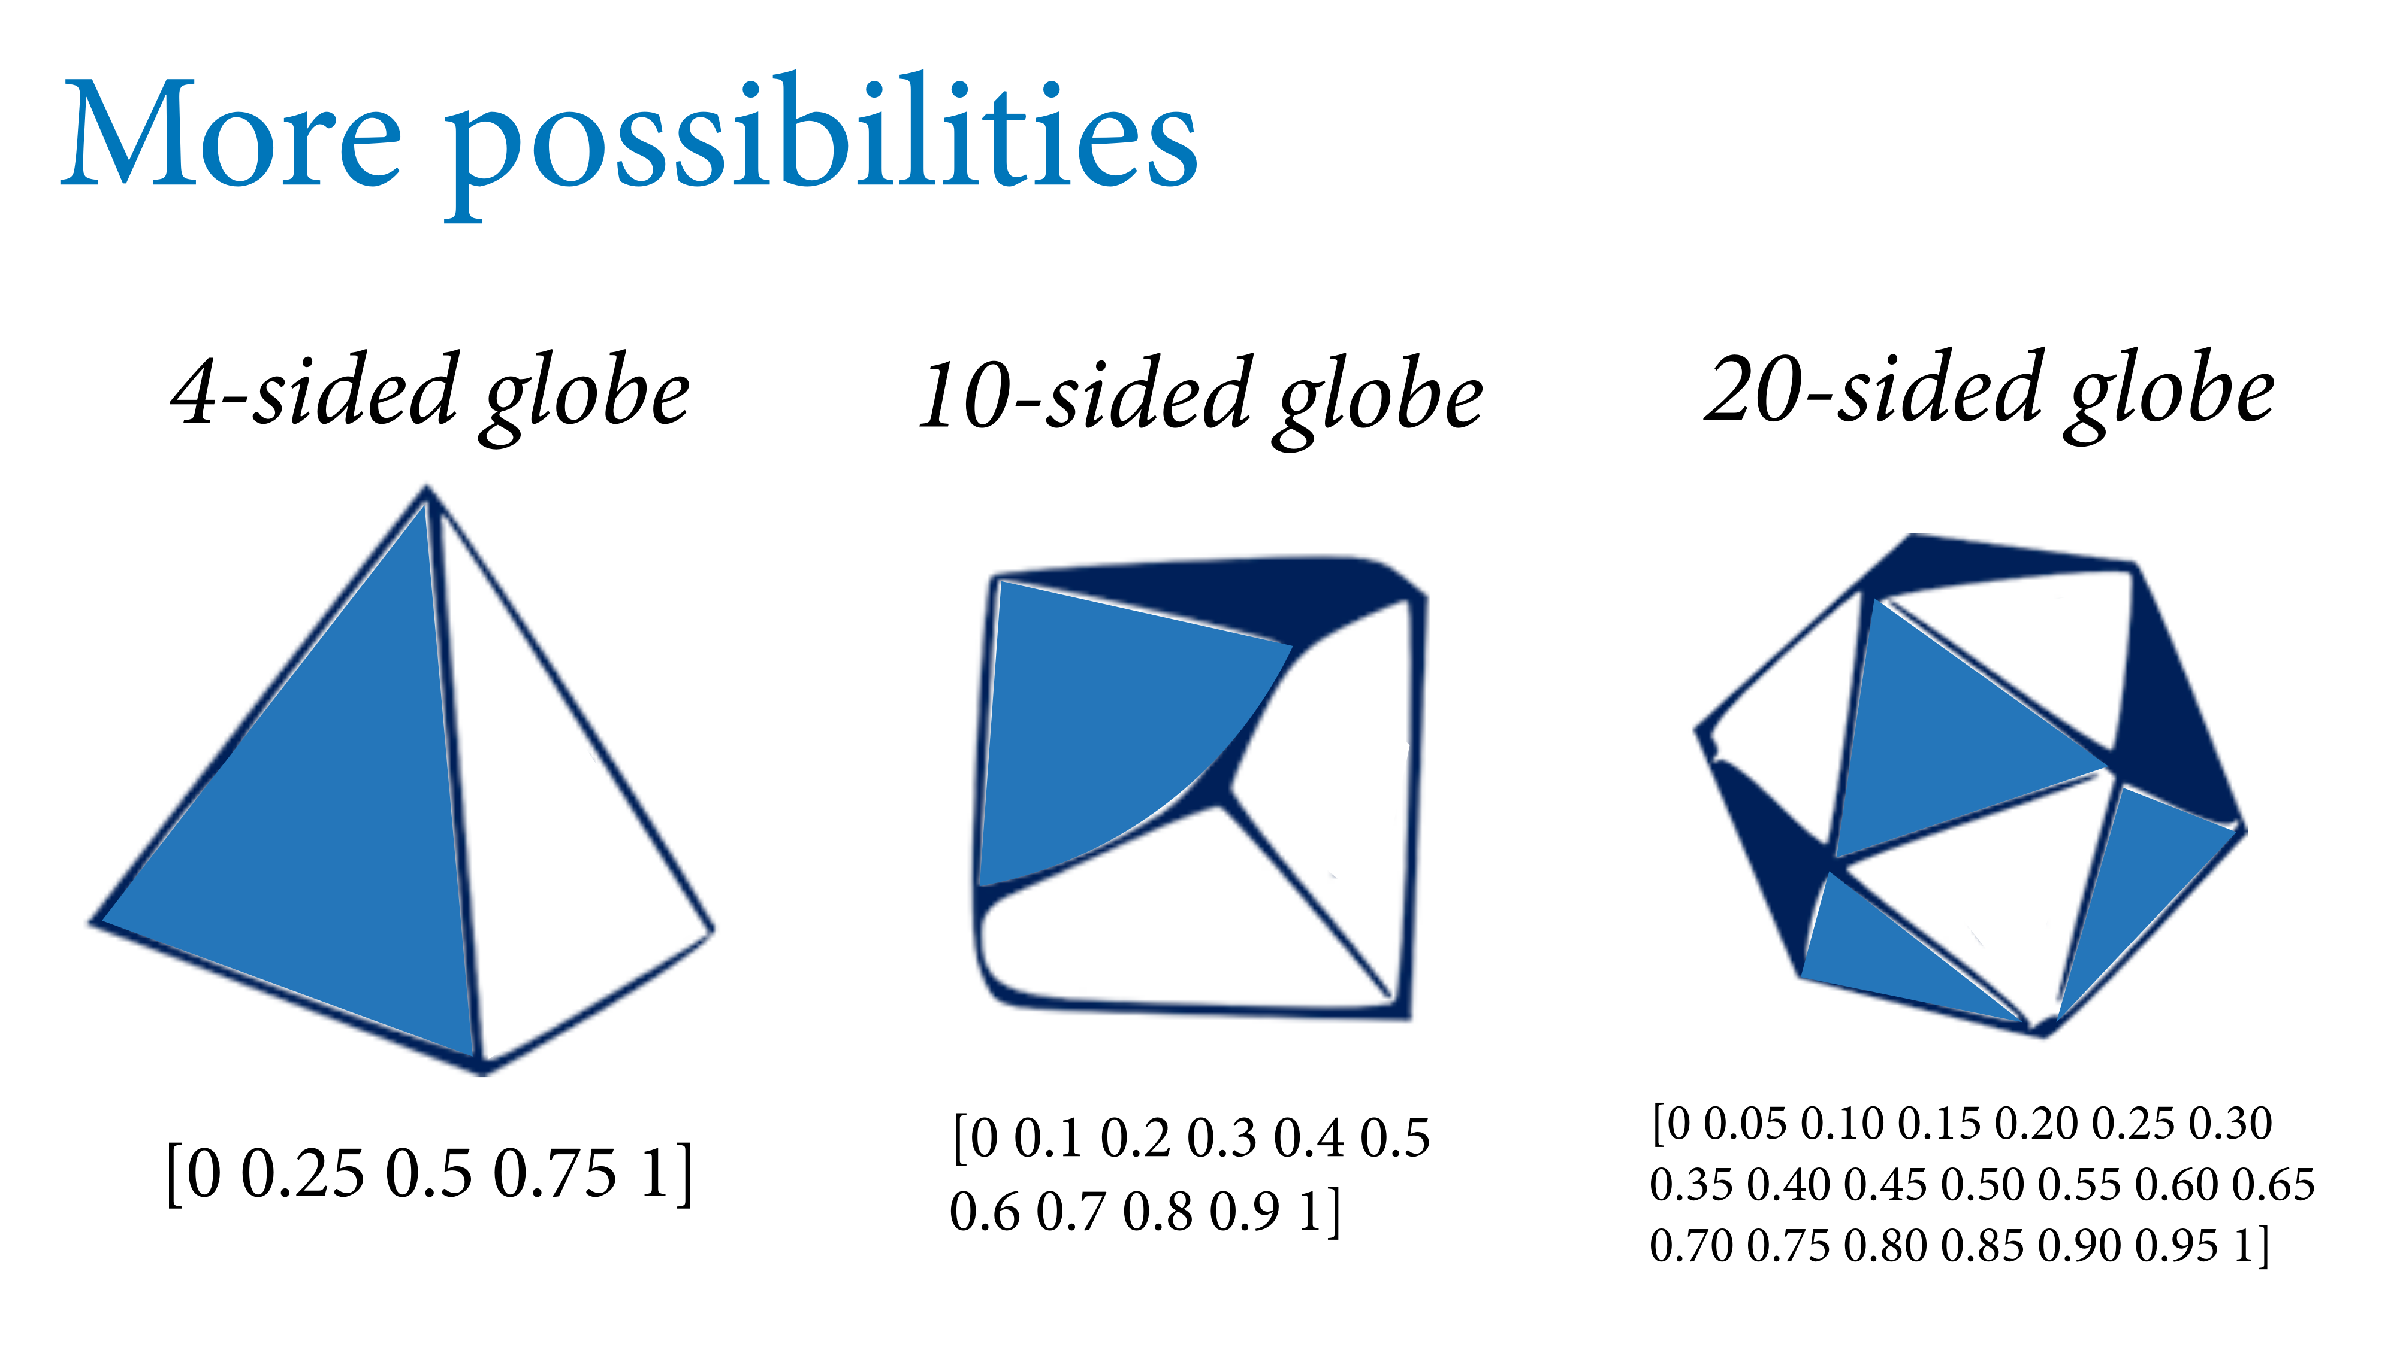

Slide 48
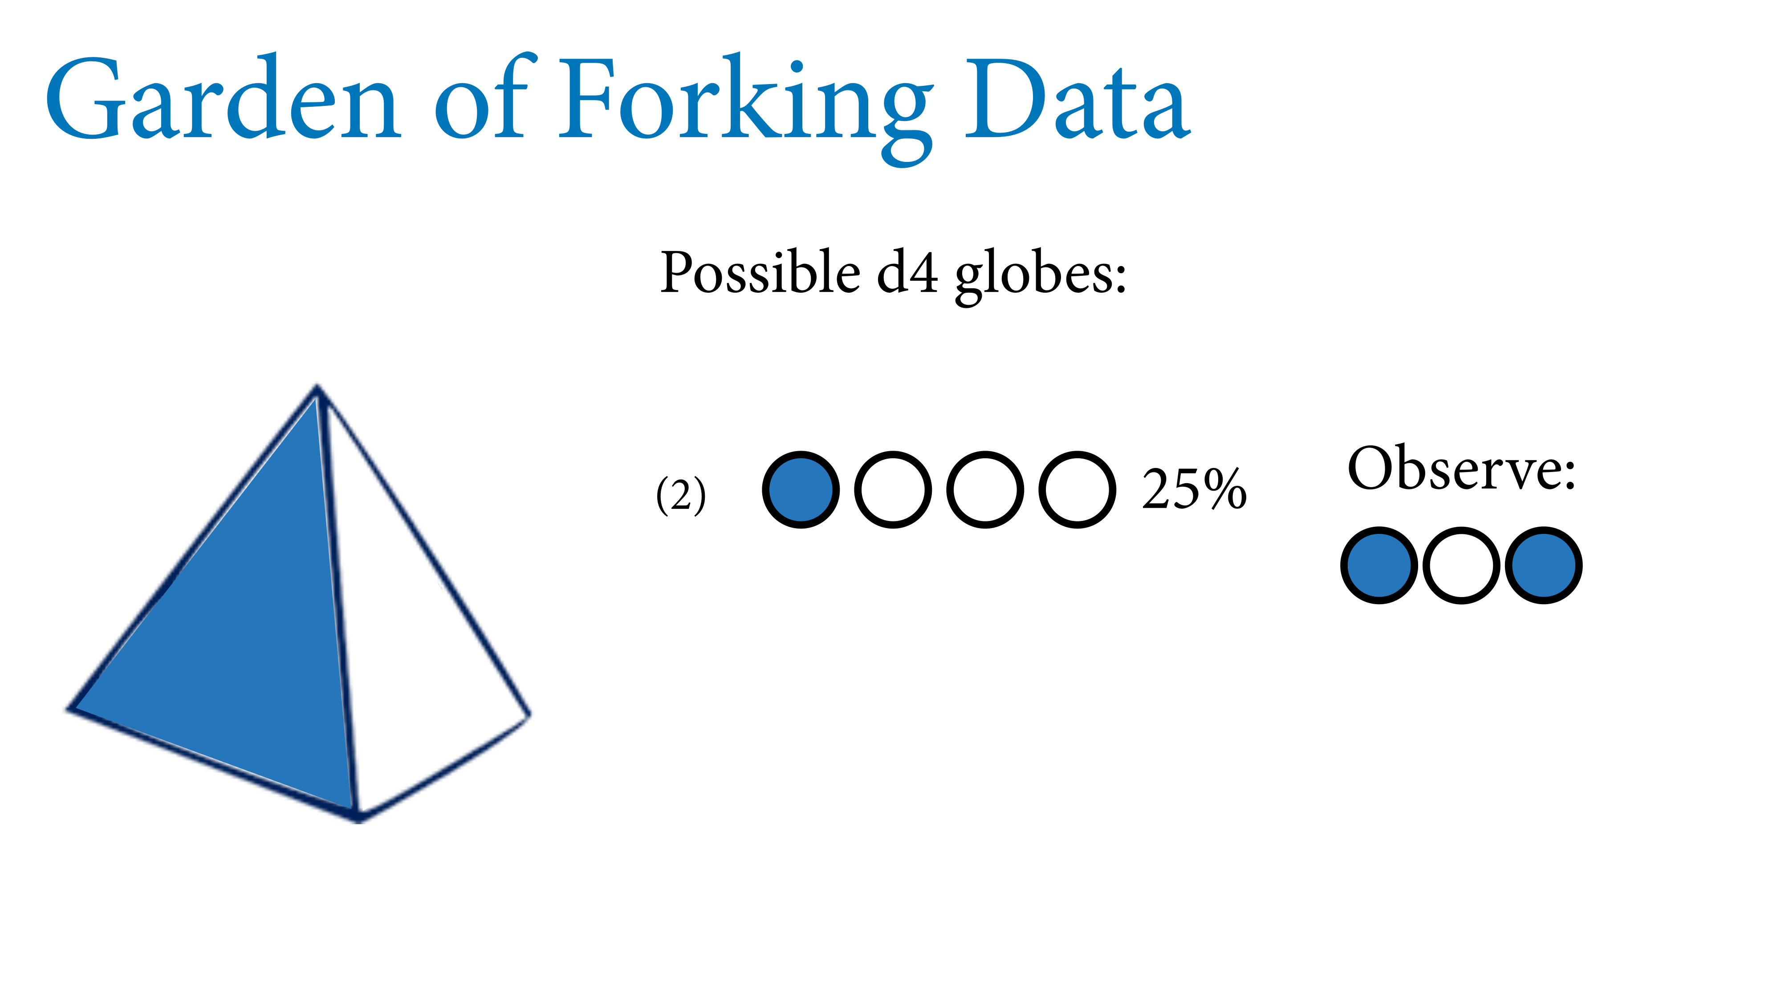

Slide 59
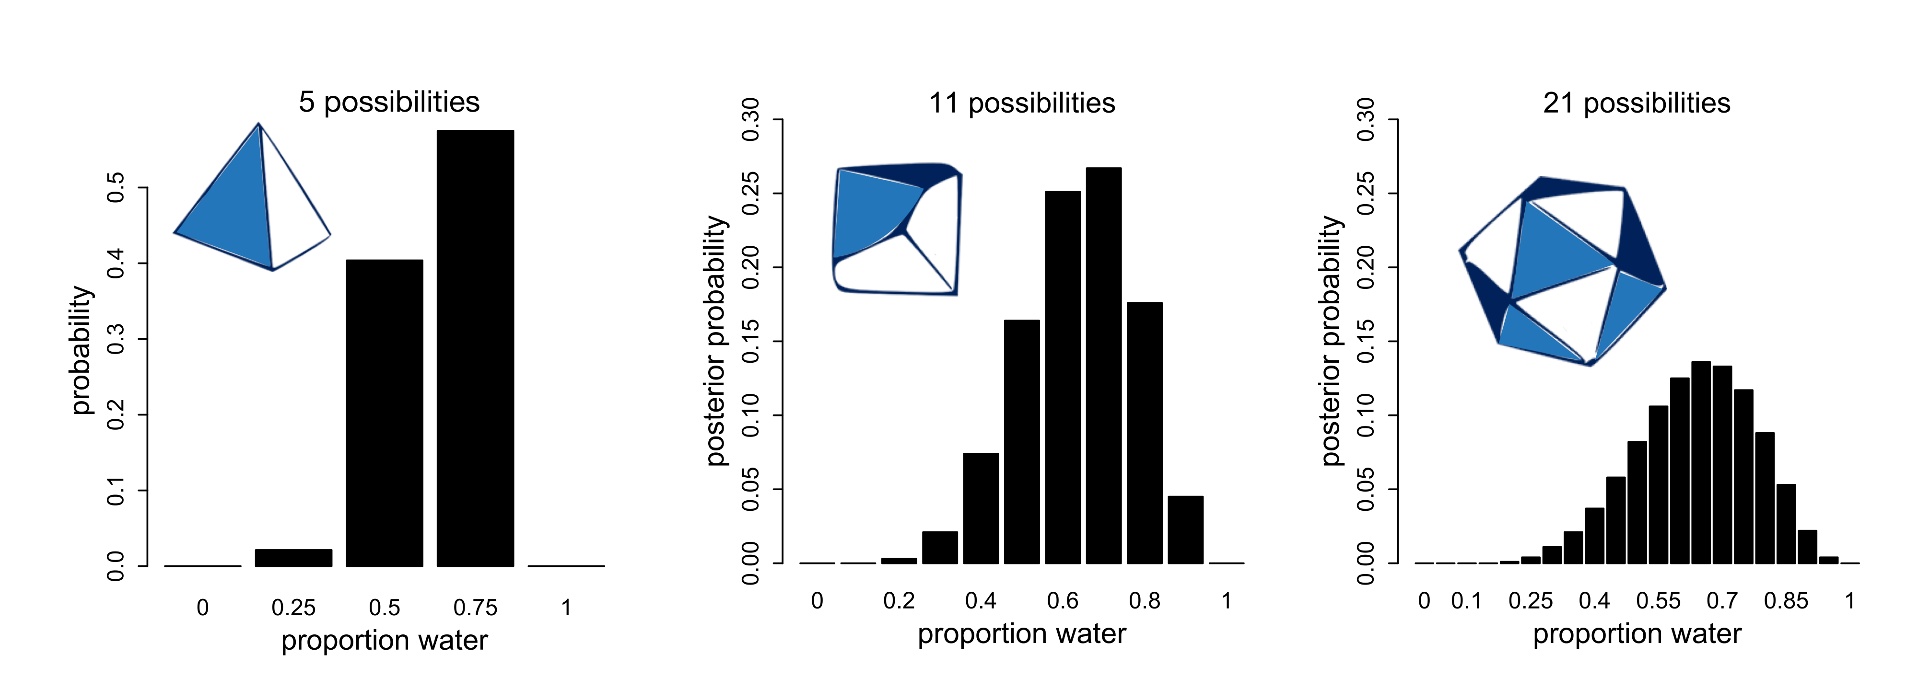

Slide 60
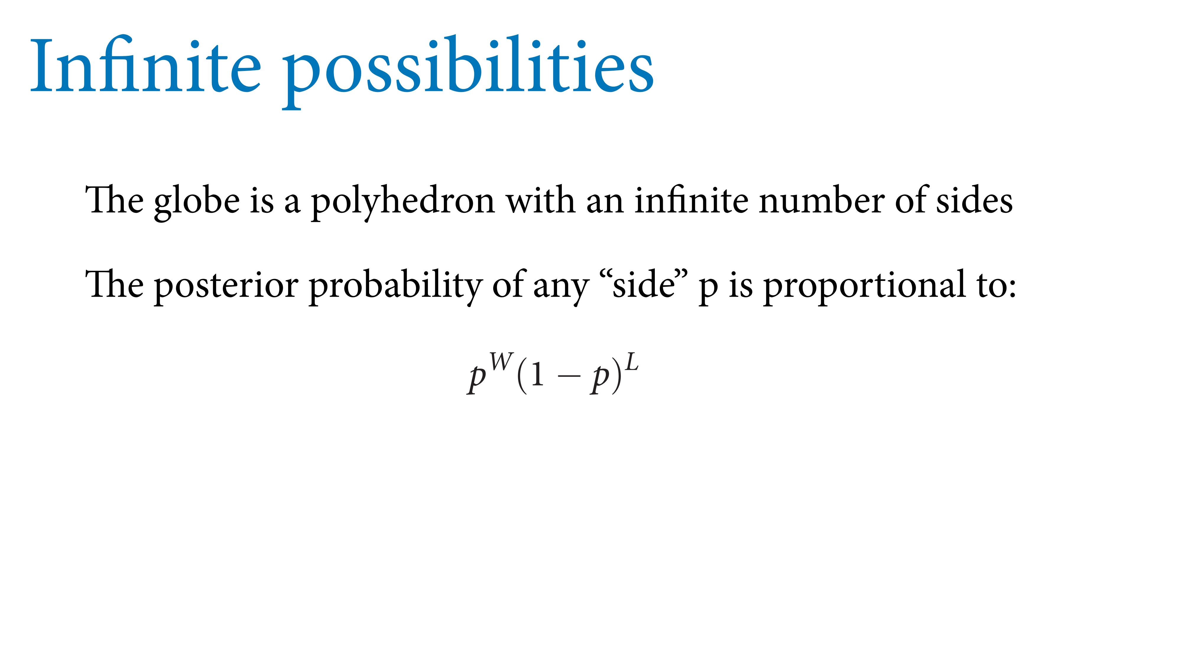

Slide 62
i.i.d. assumption = observations are independent and identically distributed

